Slide 1
Analysis of Discrimination and Racism
Days of Glory Movie

Slide 2
Introduction
The “Days of Glory” movie is a reflection of the world wars and all the events that took place during the fighting of soldiers from the African, Arab, German and white races.
It also shows the liberation which is highly portrayed by franc and Italy.

Slide 3
The movie also shows the procession of war to deliver the message of certain themes which have been clearly portrayed such as discrimination and racism.
Additionally, its major languages portrayed in the movie are French and Arabic which even proves that large numbers of wealth possessions are from the French Forces.

Slide 4
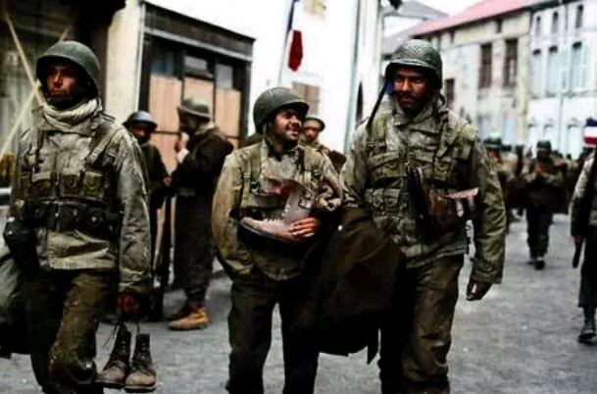
Racism
Days of Glory movie stars two different races from the African and Arab backgrounds.
It begins with a scene where tribal Chieftain of the men at Algeria come to the help of France.

Slide 5
At the end of the war, the French kill the surviving warrior (Black) to show their ingratitude.
This shows that they do not respect any of the black men even though they seem to have rescued them from their enemies.

Slide 6

The French are therefore characterized by selflessness because their native recruits are fighting for their mother country.

Slide 7
Discrimination
Discrimination occurs where the French are not interested in what the Arabs have to contribute about the war and hence they end up disrespecting them.
The Africans who are sent to the North together with other whites fail to get promoted simply because they are discriminated against.

Slide 8
The Africans are also not allowed privileges such as to visit their families or to send any love letters to their wives.
They are also lied to by the Nazis who tell them that they will be treated well if only they surrender.

Slide 9

This is a trick because in real sense they are not granted any freedom when they surrender.
The German troops also engage in killing and beating up the African prisoners of war during the implementation of the Geneva Convention.

Slide 10
Conclusion
In conclusion, the movie is a clear indication of the contribution the North African soldiers made to the free French forces while the wars were in progress.
Also, it depicts that the African soldiers together with the Arab solders were highly discriminated against and their potential was not recognized due to their racial construct.

Slide 11
However, they played a great part in saving the French during the world wars and hence they should have been treated better.
The film maker however sought to show how these races were highly discriminated against simply because of their races.
Hence, discrimination and racism are the major themes portrayed in the “Days of Glory” movie.

Slide 12
References
Wilson, E. (2007). “Days of Glory.” Film Quart, 61(1), 16-22.

